Slide 1
Unit-6
A) Looking to the future with HTTP/2.
B) Automating optimization with gulp.

Slide 2
This chapter covers:
 Learning the history of HTTP/1 and its problems.
 Exploring the evolution of HTTP/2.
 Understanding request multiplexing and header compression, new in HTTP/2.
 Exploring how optimization practices differ between HTTP/1 and HTTP/2.
 Speeding the delivery of crucial page assets by using Server Push.
 Optimizing for HTTP/1 and HTTP/2 clients on the same server.

Slide 3
Understanding why we need HTTP/2
The need for HTTP/2 is due to the shortcomings of HTTP/1, which is now a legacy protocol that’s ill-equipped to handle the demands of modern websites. To know why we need a new protocol, we need to understand the problems inherent in HTTP/1. In this section, you’ll explore those problems and how HTTP/2 solves them. Then you’ll go on to write an HTTP/2 server in Node.

Slide 4
Understanding the problem with HTTP/1
HTTP originated in 1991 with the invention of HTTP/0.9. This protocol, which was capable of using only a single method (GET), was originally designed for a much simpler “web” of electronic documents. These documents, written in HTML, were imbued with the ability to link to other documents via anchor tags. The HTTP 0.9 protocol achieved this goal admirably. As time marched on, two new implementations of HTTP with additional capabilities and methods (such as POST for submitting form data) were added. These versions were v1.0 and v1.1, which were standardized in 1996, with support added in most browsers shortly thereafter. HTTP/1 thus became the workhorse of the web for many years since. What occurred next, however, was that the web transformed from serving simple HTML documents to complex sites and applications, a phenomenon illustrated in figure 11.1. The increasing complexity of the web means that richer experiences are possible through higher-quality media and content. The problem, however, is that an ongoing race between this complexity of content and the ability to serve it in a high-performing way has been raging since the first web developer dared to believe that the web was for more than serving static text documents. Although developers have come up with ingenious ways around common performance problems in HTTP/1, three significant

Slide 5

problems still plague the protocol: head-of-line blocking, uncompressed headers, and nonsecure websites.

Slide 6
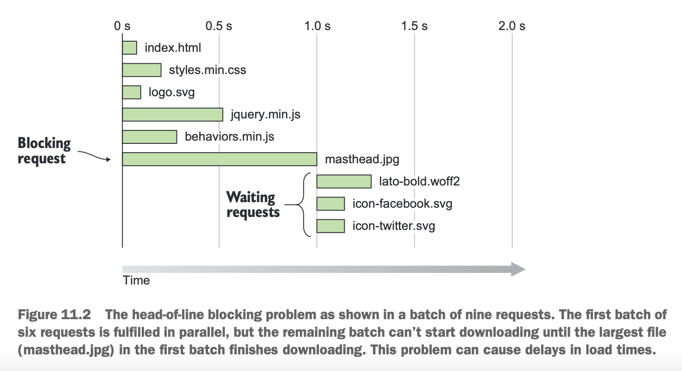
HEAD-OF-LINE BLOCKING
The biggest problem plaguing HTTP/1 client/server interactions is a phenomenon known as head-of-line blocking. This manifests from the HTTP/1 protocol’s inability to handle more than a small batch of requests at the same time (typically, six at once). Requests are responded to in the order that they’re received, and new requests for content can’t begin downloading until all requests in the initial batch have finished. Figure 11.2 illustrates this problem.

Slide 7
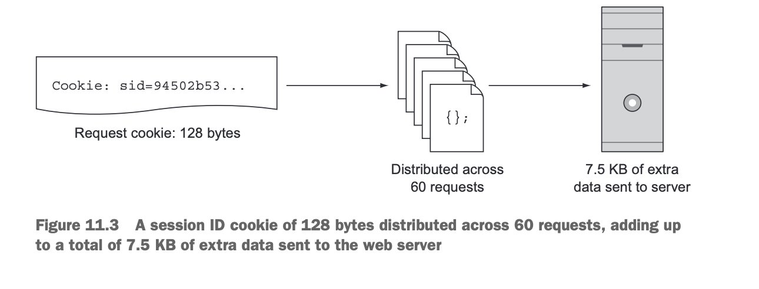
UNCOMPRESSED HEADERS
As you know by now, when you request assets from a web server, headers accompany the request to and response from the web server. These headers describe many aspects of the request and response for an asset, most of which are expressed in redundant fashion. A perfect example of this is the Cookie request header. Cookies are often used to track user sessions, and as such, contain session IDs. Imagine a web page that comprises around 60 assets, each carrying a cookie with a session ID of 128 bytes in length. Every single request must upload an additional 128 bytes of data to the server indicating the domain for which the cookie is valid. This isn’t much when spread across a few requests, but imagine a page with 60 requests with this cookie attached. The client must send 7.5 KB of extra data to the server across all of those requests. Figure 11.3 illustrates this concept.

Slide 8
NONSECURE WEB SITES
Although not necessarily a performance issue per se, HTTP/1 servers aren’t required to implement SSL for their visitors. In an increasingly dangerous world in which data is regularly stolen and used by hackers to impersonate people, securing your website is necessary to ensure privacy and a safer web-browsing experience for your visitors. Because HTTP/1 doesn’t mandate implementation of SSL, it’s entirely optional to implement. If security measures are optional, people likely won’t implement them. People are reluctant to change, and will usually do so only when forced to, or when an adverse event occurs. Although this failure couldn’t be foreseen when HTTP was first developed, this requirement can’t be retroactively applied to force site owners to secure their websites. The cat is already out of the bag, so to speak. These aren’t the only problems that HTTP/1 causes, but they’re major issues worthy of concern. Fortunately, solutions to these problems are inherent to HTTP/2 because of the way the protocol was designed.

Slide 9
Solving common HTTP/1 problems via HTTP/2
HTTP/2 didn’t appear out of thin air. It was preceded in 2012 by a protocol named SPDY (pronounced speedy), which was developed by Google to address the limitations of HTTP/1. When the first draft of the HTTP/2 specification was written, its writers capitalized on the advances of SPDY and used it as a starting point. Now that HTTP/2 support has grown considerably, Google has removed SPDY support from Chrome 51 and later, and other browsers will follow suit. Let’s see how HTTP/2 fixes the two problems outlined earlier in HTTP/1.
NO MORE HEAD-OF-LINE BLOCKING
Unlike HTTP/1, which has a limit on the number of requests it can satisfy before it can begin responding to other requests in the queue, HTTP/2 can satisfy many more requests in parallel by implementing a new communication architecture. Unlike HTTP/1, which uses multiple connections to transfer assets, HTTP/2 uses one connection capable of handling many, many more requests in parallel. A connection consists of these components in the following hierarchy: Understanding why we need HTTP/2 279.
 Streams are bidirectional communication channels between the server and the browser. A single stream consists of a request to and a response from the server. Because streams are encapsulated by the connection, many assets can be downloaded in parallel within the same connection by using multiple streams.
 Messages are encapsulated by streams. A single message is the rough equivalent of an HTTP/1 request to or response from the server, providing the mechanism needed to request assets, and to receive the content of those assets from a web server.
 Frames are encapsulated by messages. A frame is a delimiter in a message that indicates the type of data that follows. For example, a HEADERS frame in a response message indicates that the following data represents the HTTP headers for the response. A DATA frame in a response message indicates that the following data is the content of the requested asset.

Slide 10
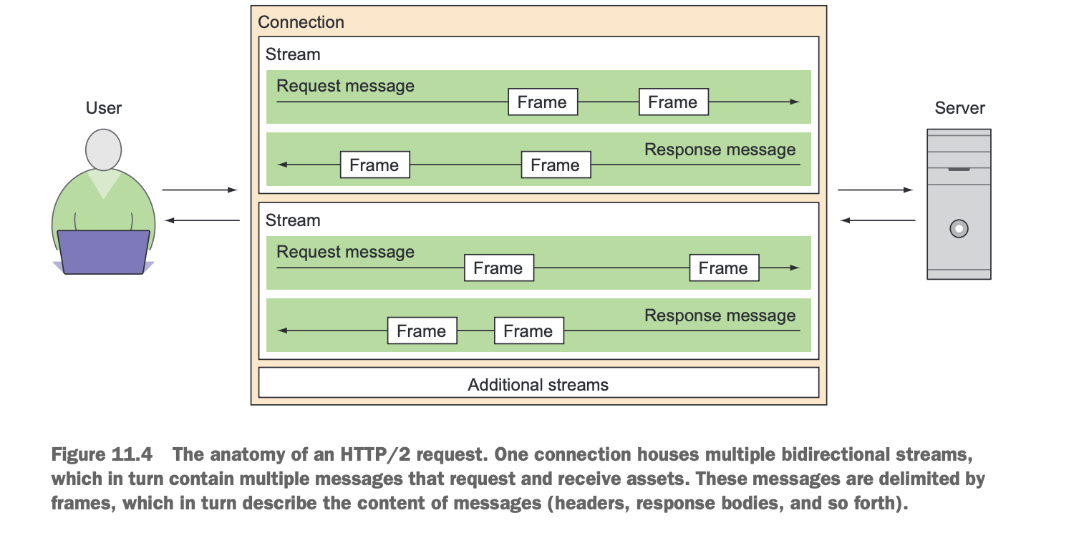
When you visualize this process, you get something like figure 11.4. Because of this design, requests to HTTP/2 servers are cheap. Cheap enough, in fact, that bundling isn’t worth the effort and could even lead to slower load times in some scenarios. The next main section covers the specifics, but the bottom line is that you no longer have to resort to antipatterns such as image spriting and bundling (though those techniques are useful in HTTP/1 clients and servers, many of which are still in the wild).

Slide 11
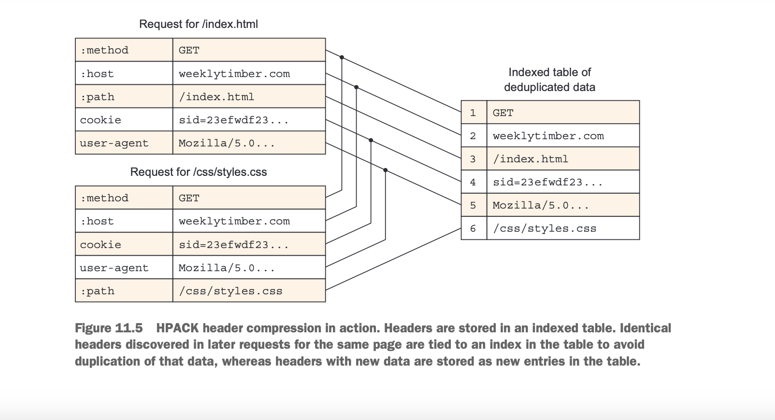
HEADER COMPRESSION
Headers in HTTP/1 are uncompressed, even when server compression is used, as I said in the preceding section. Server compression transforms only the asset, and not the headers that accompany it. Although headers don’t make up the bulk of a page’s total payload, they can add up quickly. HTTP/2 fixes this problem by incorporating a compression algorithm called HPACK. HPACK not only compresses header data, but also strips redundant headers by creating a table to store duplicates. In HTTP/1 request headers, you’ll notice that headers with longer content, such as Cookie and User-Agent, are unnecessarily attached to every single request, creating a potentially huge set of redundant data that must be transferred along with the request to the server (as illustrated in figure 11.3). HPACK deduplicates headers via a table that uses indexes to keep track of duplicate header data found across requests. This is structured like a typical database table with indexes. When new header values are discovered, they’re compressed, stored in the table, and given a unique identifier. If additional headers are discovered that match any previously indexed headers, the relevant identifier in the table’s index is referenced rather than redundantly stored. Figure 11.5 shows this behavior. This process is done on the client side when requests are made, and the table is transferred to and disassembled by the server and used to build the response. The server then repeats this process for the response headers, replies, and the client disassembles the server-generated response table, and applies the headers to the responses for each downloaded asset. The result is deduplicated headers and compressed data that’s presented in the same way HTTP/1 headers are, making the process transparent. Your website loads a little faster for the trouble.

Slide 12
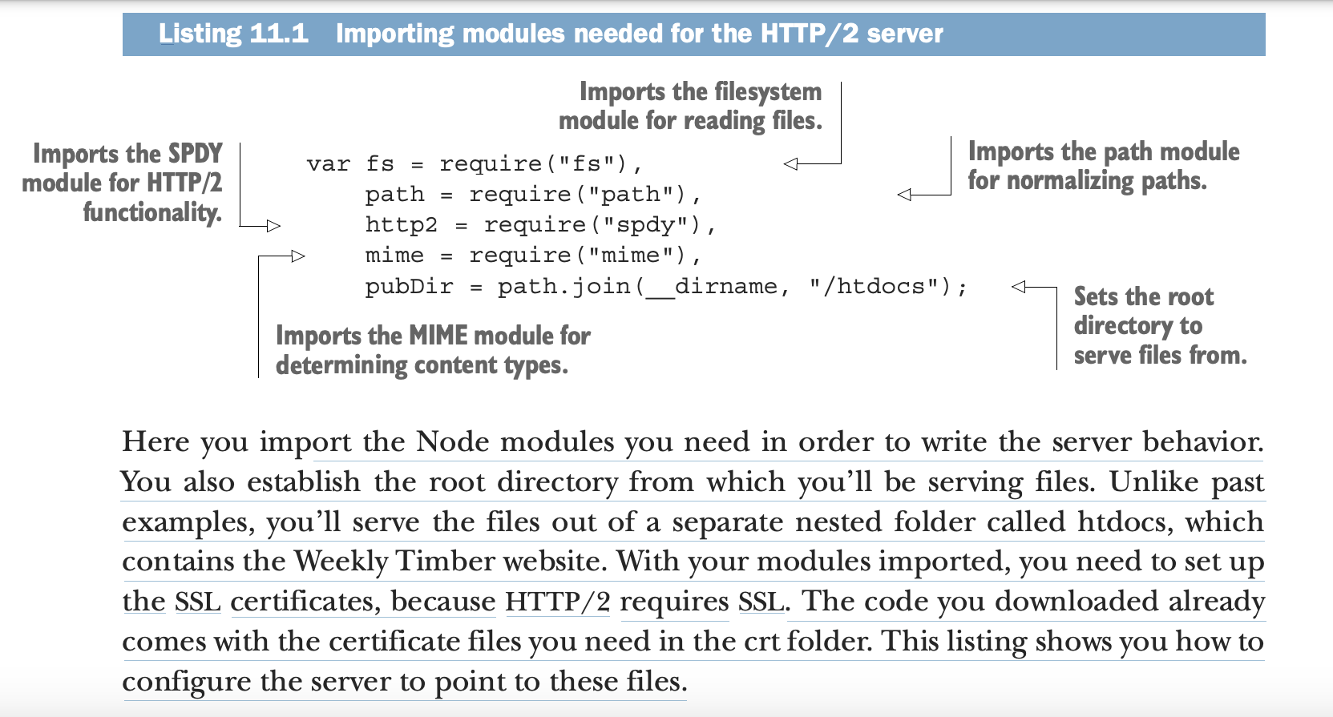

Slide 13
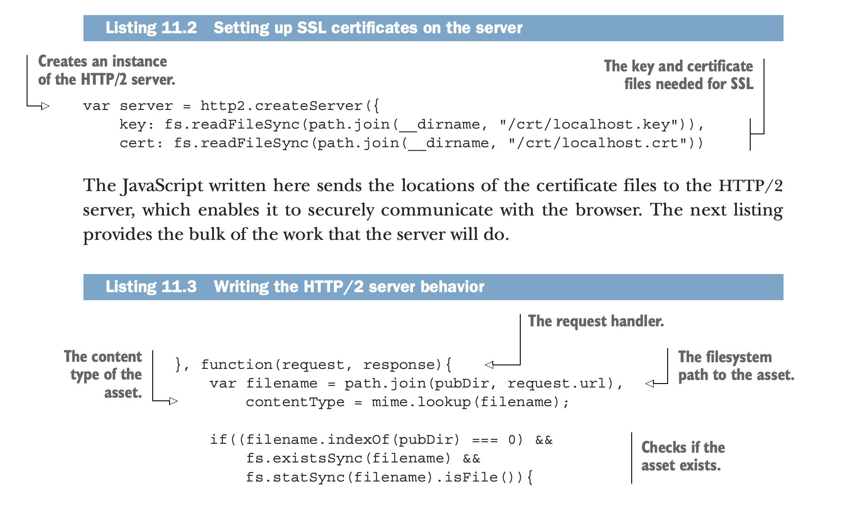

Slide 14
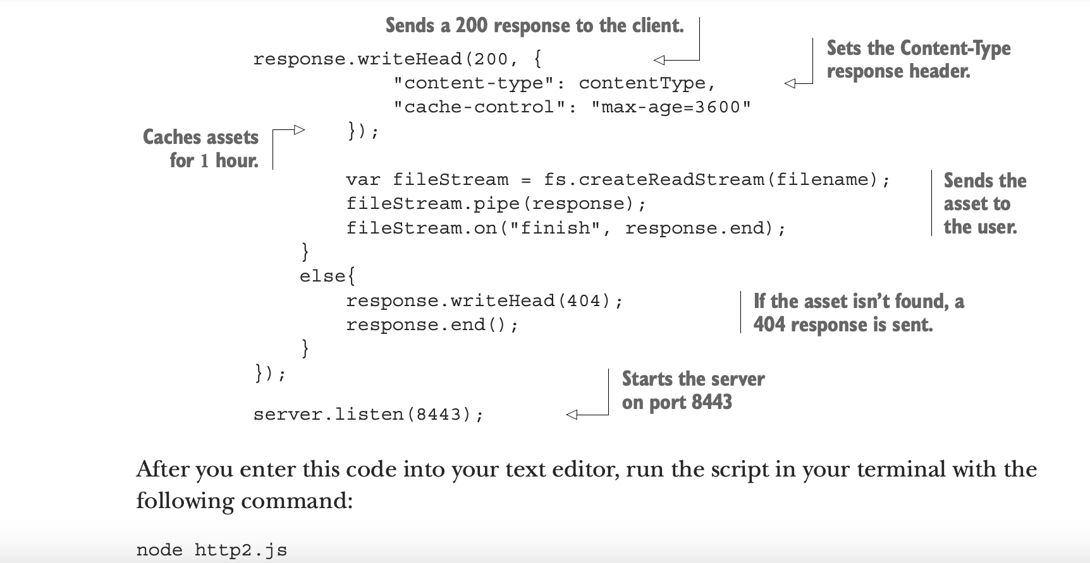

Slide 15
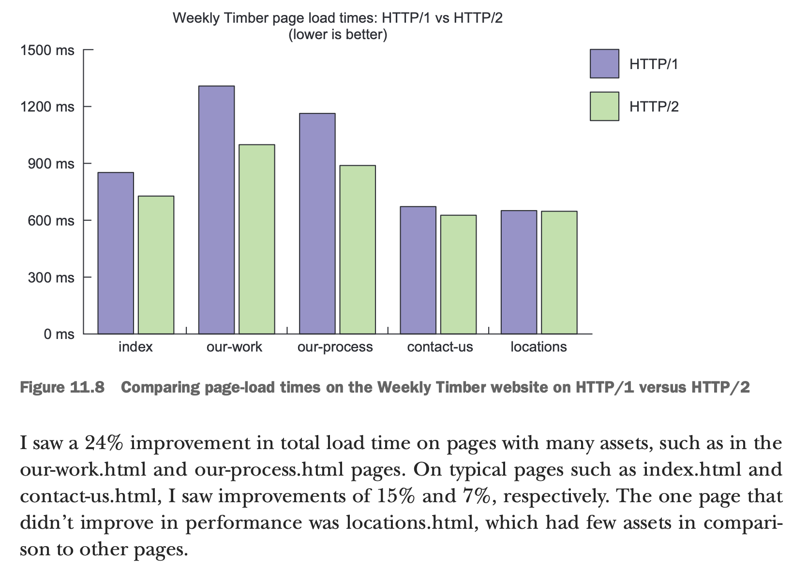

Slide 16
Exploring how optimization techniques change for HTTP/2
“Oh great,” you’re thinking. “I got this book on web performance, and everything I learned in it is wrong.” Not necessarily. Although some techniques covered in this book are antipatterns when applied to HTTP/2 client/server interactions, they don’t necessarily impede the protocol’s performance—but they can affect the effectiveness of your caching policy. The rules of optimization techniques on HTTP/2 are this simple:  Techniques that reduce the size of assets are things you should still do on HTTP/2. These are techniques such as minification, server compression, and image optimization. Reducing the size of an asset contributes to lower load times, always and forever.
 Techniques that combine files are things you should stop doing on HTTP/2. Although useful in alleviating latency in HTTP/1 client/server interactions, requests are much cheaper in HTTP/2, and combining files can have an adverse effect on your caching effectiveness. The first rule speaks for itself, but we need to talk a bit more about the second rule, how caching is affected by concatenating resources, and what antipatterns fit under concatenating.

Slide 17
Asset granularity and caching effectiveness When you set out to squeeze every last drop of performance out of HTTP/1, you adopted many techniques that, albeit effective, are hacky in HTTP/2 environments. The main category of techniques that hurt HTTP/2 performance are those that rely on concatenation. Concatenation is the process of combining files in order to reduce the number of HTTP requests that are sent. As I said before, this is great for HTTP/1, but it could harm performance on HTTP/2. Why is this, exactly? The answer is in caching. As you learned in chapter 10, caching helps reduce the payload of a page on visits subsequent to the first. The problem isn’t in caching itself, however, because a properly configured caching policy will operate whether or not we concatenate files. The problem is that when you concatenate files, you’re reducing the efficiency of your caching when assets change. This is true of Exploring how optimization techniques change for HTTP/2 287 both protocols, but when using HTTP/1, you were willing to forego a certain level of efficiency to minimize load times for users visiting a site for the first time. Here’s a good example of how concatenation hurts caching: Say you have an image sprite of icons, and you need to update just one icon in the set. Even though you’ve changed only one of the icons, the asset is monolithic, and must thus be purged from browser caches. This creates an issue as the entire file must be invalidated and retrieved, even though only a portion of it has changed. This is illustrated in figure 11.10. In HTTP/1 optimization workflows, we accepted this suboptimization as just a bump on the road to building fast websites. Now that HTTP/2 affords us cheaper connections, you don’t have to make the choice between shorter page-load times for firsttime visitors and efficient caching. You can have your cake and eat it, too! Next up, let’s look at techniques you should avoid when your site is on HTTP/2.

Slide 18
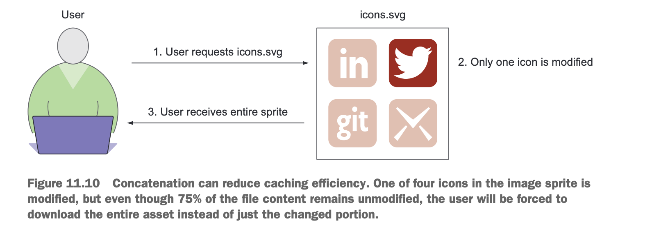

Slide 19
Sending assets preemptively with Server Push In the past, if you wanted to speed up page rendering, you’d inline assets into your HTML. It wouldn’t appreciably decrease the size or overall load time of the page, but it would have the potential benefit of decreasing the rendering time of a web page. Of course, as said before, asset inlining is an antipattern that, although effective for sites running on HTTP/1, ruins the effectiveness of a good caching policy for the inlined content. We’re willing to accept this shortcoming on HTTP/1 for the trade-off of a lower perceived load time. So if you’re not supposed to inline assets on HTTP/2, how do you achieve the benefits of inlining? With a new featured called Server Push! In this section, you’ll learn about this feature, how it works, how to use it in your Node-driven HTTP/2 server, and the benefits of its use.

Slide 20
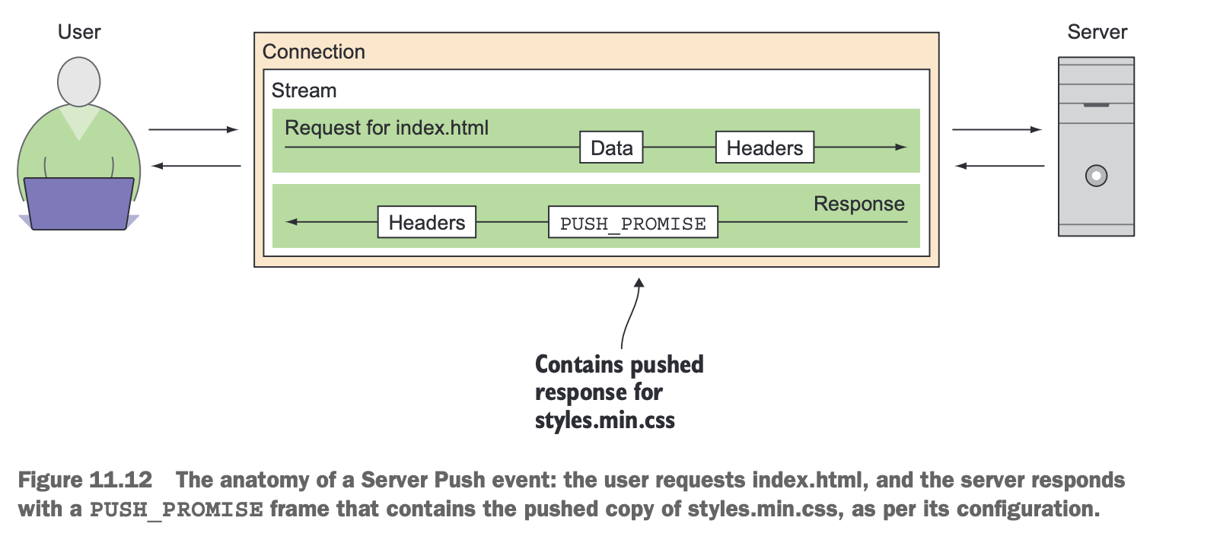
Understanding Server Push and how it works Server Push is a feature available in HTTP/2 that enables you to realize the benefits of asset inlining while still maintaining the granularity of your page assets. It’s a mechanism that allows the server to “push” assets the user hasn’t explicitly requested but needs in order to render a page. When Server Push is used, the user makes a request for a page. Then, depending on its configuration, the server can reply with the contents of the requested document, along with assets that the server was configured to “push” to the client. Imagine that a user goes to the Weekly Timber website (which runs on an HTTP/2 server for the purpose of this example) and requests index.html.

Slide 21
HOW SERVER PUSH IS TYPICALLY INVOKED
For web servers such as Apache that are running HTTP/2, Server Push is invoked by setting up a Link HTTP response header when a specific asset is requested: Link: ; rel=preload; as=style If this looks familiar to you, it’s because the preload resource hint HTTP header covered in chapter 10 takes on the same format. That said, don’t confuse this with the tag used for resource hints! You don’t need to modify your site’s HTML to use Connection Stream Response Request for index.html User Server Headers Headers Data PUSH_PROMISE Contains pushed response for styles.min.css Figure 11.12 The anatomy of a Server Push event: the user requests index.html, and the server responds with a PUSH_PROMISE frame that contains the pushed copy of styles.min.css, as per its configuration. Sending assets preemptively with Server Push 291 Server Push, as it’s a server-driven behavior. If you’re modifying your HTML to add a preload resource hint via the tag, and expecting Server Push to just magically work, you’re mistaken, It’ll just preload the resource for the user; it won’t invoke a Server Push event. For web servers that implement Server Push in the fashion shown previously, it’ll take the asset specified inside the angle brackets and serve it simultaneously with the asset that the header was set for (usually an HTML file). The as attribute is there only to inform the browser of the nature of the pushed content, and isn’t necessary for Server Push to work. In this case, a value of style is used to indicate that the pushed resource is a CSS file.

Slide 22
WRITING SERVER PUSH BEHAVIOR IN NODE
Because you’re responsible for implementing all of your own behavior for your Node HTTP/2 server, you can’t set a Link header and expect Server Push to work. You need to write the logic that pushes content to the client. Mercifully, this logic isn’t much different from the typical way you serve assets to the user. The only difference is that you create a separate push response on requests for specific assets. For example, the Weekly Timber website has a style sheet named styles.min.css, and maybe it would make sense to push that CSS to the client whenever it requests an HTML file. Makes sense, especially because every HTML file on Weekly Timber’s site references this CSS. Listing 11.4 Pushing content in Apache when a user requests an HTML file Informing the browser of other pushed content types If you want to inform the browser of the nature of the pushed content for content types other than style, you can find a full list of content types to use with as in the W3C specification for this feature at http://mng.bz/r84O. 292 CHAPTER 11 Looking to the future with HTTP/2 So let’s do just that. Pull up the http2.js web server you wrote earlier in this chapter, navigate to the request handler function that serves assets to the client, and enter the code in the following listing right before the response.writeHead call that sendsthe 200 response to the client.

Slide 23
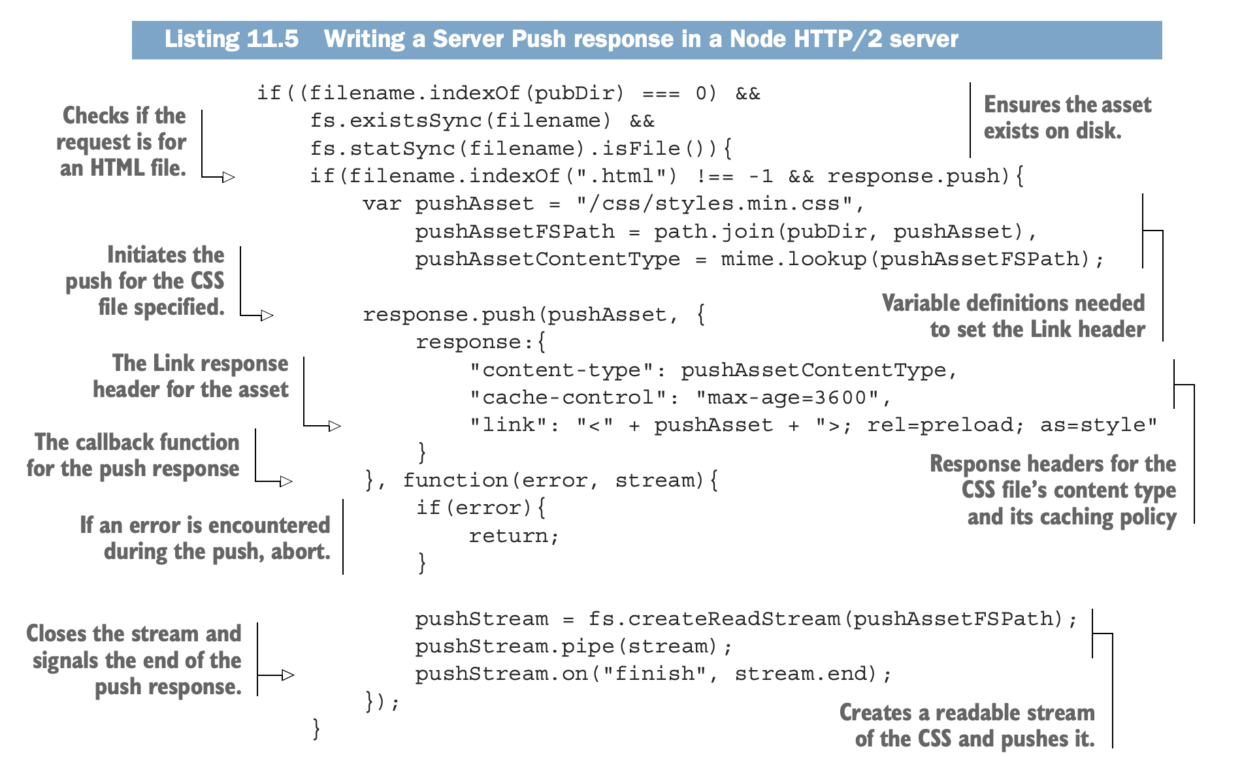

Slide 24
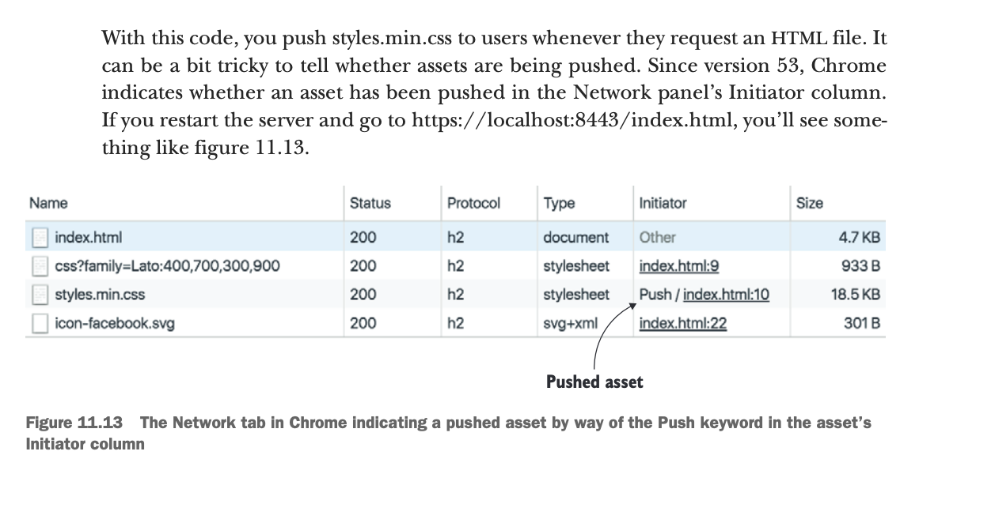

Slide 25
Measuring Server Push performance Measuring Server Push performance is tricky. Locally, it can be difficult. Possible ways to measure performance include disabling throttling, or hosting the website on a remote HTTP/2 server, and measuring performance under real network conditions. The problem in testing locally without throttling is that it’s not a realistic scenario. In my case, I set the website on a remote HTTP/2 server to test Server Push. To test, I set up a version of the client’s website with Server Push enabled at https://serverpush .jeremywagner.me, which pushes the site’s CSS to the user on all HTML pages. A version of the same site without Server Push was set up for comparison at https://h2.jeremywagner.me. The test results between the two can be seen in figure 11.14. When the CSS was pushed to the user, the page began painting about 19% faster than when not pushed. On my broadband connection, this translated to about an 80 ms increase in rendering speed. This is nothing to sneeze at, especially when you consider Profiling HTTP/2 Server Push on the command line A solid way of finding out whether an asset is being pushed is to use the nghttp command-line client, which shows you all of the frames in an HTTP/2 session. If you see a PUSH_PROMISE frame and the contents of the pushed asset, you’ll know for sure that Server Push is working. You can learn more about nghttp at https://nghttp2.org/documentation/nghttp.1.html. 0 ms 500 ms 200 ms 300 ms 400 ms 100 ms Effect of Server Push on TTFP (lower is better) Server Push No Server Push Figure 11.14 Time to First Paint comparison with and without Server Push for the client website’s CSS 294 CHAPTER 11 Looking to the future with HTTP/2 that devices on slower mobile networks will realize a proportionately larger increase in rendering speed. Considering that it takes little effort on most servers to use, it’s practically a gimme for the performance-minded web developer. Although Server Push is difficult to use “incorrectly,” so to speak, you need to remember a few basic guidelines when you use it:  You’re not limited to pushing just one asset. You can modify your Node HTTP/2 server code to push more than one asset, or add more Link headers for other HTTP/2 servers to push multiple assets at a time.  Don’t push what you don’t need. Makes sense, right? It may be tempting to push everything and the kitchen sink to the client, but push only what makes sense. A good rule of thumb is to push assets that are used on all pages of your site.  You can push assets that aren’t on the current page. Yes, you can push an asset that isn’t even needed by the current HTML document. You may decide to do this in order to preload an asset that’s on a page you anticipate that the user may navigate to. Of course, this can be dicey, and you may end up wasting the user’s bandwidth. If you don’t have a good reason for doing this, then don’t do it.

Slide 26
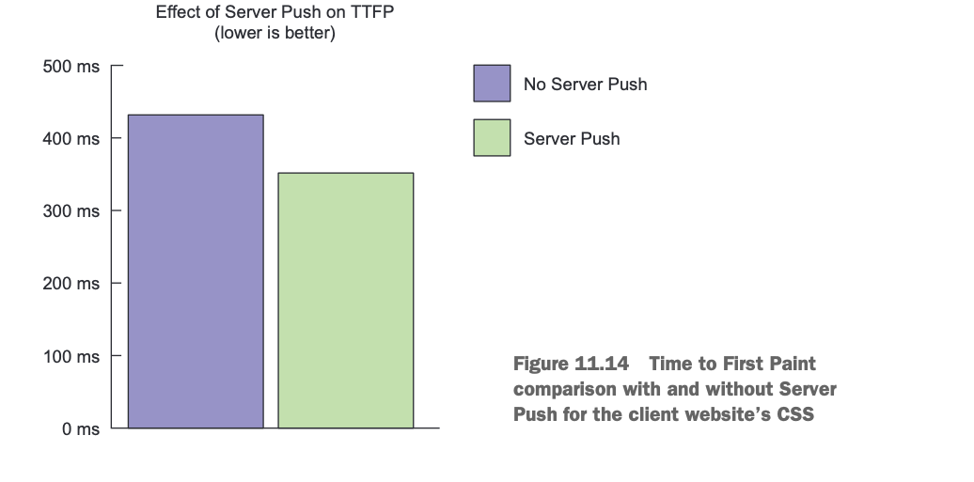

Slide 27
Optimizing for both HTTP/1 and HTTP/2 You’ve heard the expression having your cake and eating it too. This section is all about allowing your website’s visitors to have all the benefits of your optimization techniques, whether or not their browser can support HTTP/2. This section covers what happens when a visitor arrives at your HTTP/2-powered site using an HTTP/2-incapable browser. You’ll learn how to use Google Analytics to determine the segment of your users incapable of using HTTP/2, and how to transform your Node server to accommodate optimization techniques for both protocols. It should be made clear before we proceed that this section is illustrating a proof of concept. The methods in this section aren’t necessarily designed to be a robust way of solving this problem, but rather that a solution to the problem exists. If you discover a more efficient approach using tools apart from those used here, give it a go and see how it works. Let’s begin!

Slide 28
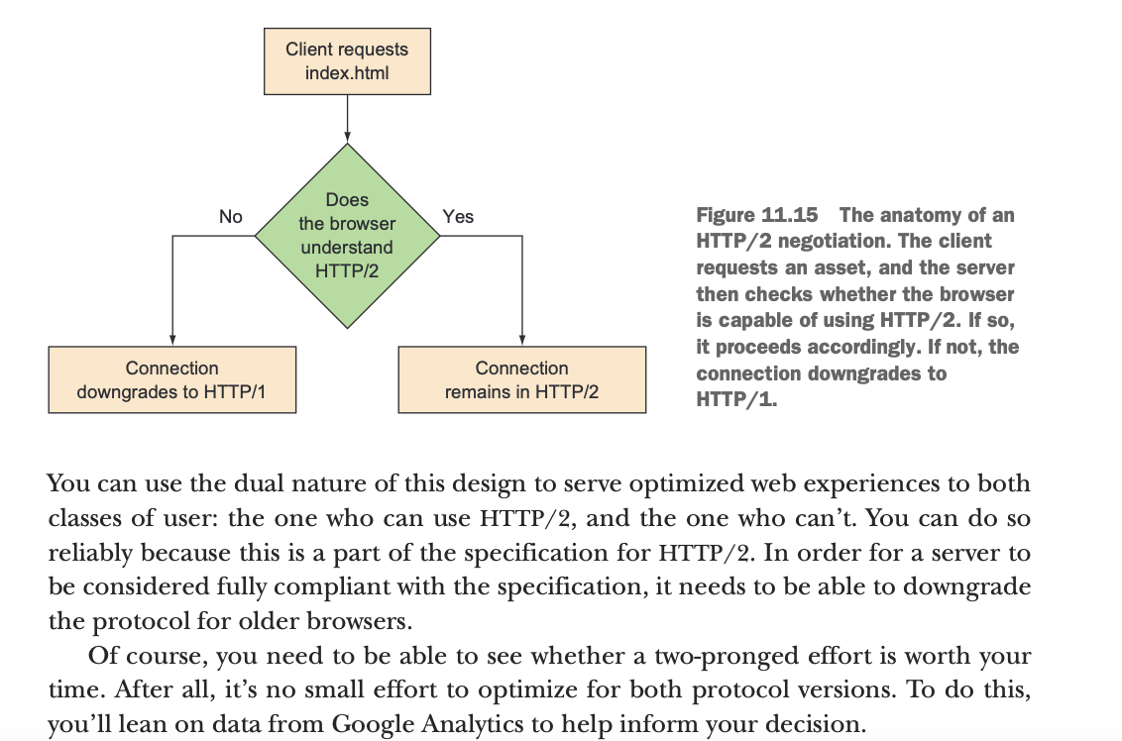
How HTTP/2 servers deal with HTTP/2-incapable browsers Up to this point, you may have been curious about how browsers that don’t support HTTP/2 can communicate with HTTP/2 servers. The fact is that under the hood of every HTTP/2 server is an HTTP/1 server waiting for a client to come along that doesn’t support HTTP/2. It’s like those alarms you see in buildings that read, “In case of emergency, break glass.” Except here, it’s more apt to say, “In case of HTTP/2-incapable browser, downgrade to HTTP/1.” When a user with an older browser comes by your HTTP/2-powered site, the connection initially begins as an HTTP/2 conversation. But if the client hints to the server that it wants to downgrade the connection to HTTP/1, the server will comply and use the older version of the protocol. Figure 11.15 illustrates this process.

Slide 29
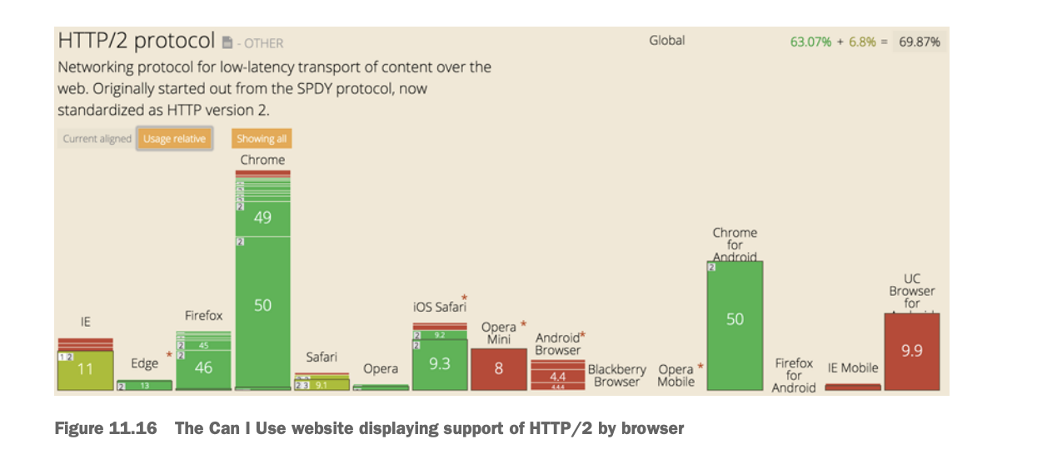
Segmenting your users Statistics are your friends, especially in a case like this when you want to see whether it’s worth the trouble to adopt two sets of optimization practices. This means combining two sources: Can I Use (caniuse.com) and Google Analytics. Can I Use is an exhaustive resource for determining the browser support for certain features, of which HTTP/2 is one. If you navigate to the site and enter HTTP/2 in the top search box and click the Usage Relative toggle button, you’ll see something like figure 11.16.

Slide 30
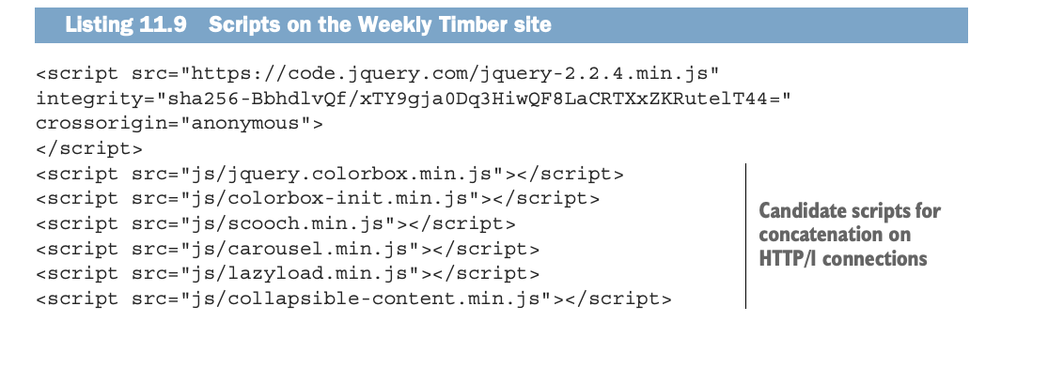
REPLACING MULTIPLE SCRIPTS WITH CONCATENATED ONES FOR HTTP/1 USERS
The Weekly Timber site has quite a few scripts in it. Seven, in fact. One of these is a CDN-hosted copy of jQuery, though, so you should look to optimize the delivery of really just six. Consider that the client-imposed maximum number of parallel requests in HTTP/1 server/client communications is usually six. If you can replace these six scripts with one concatenated version for your HTTP/1 users, you may be able to improve the delivery of site assets for those users.
The following listing shows:-

Slide 31
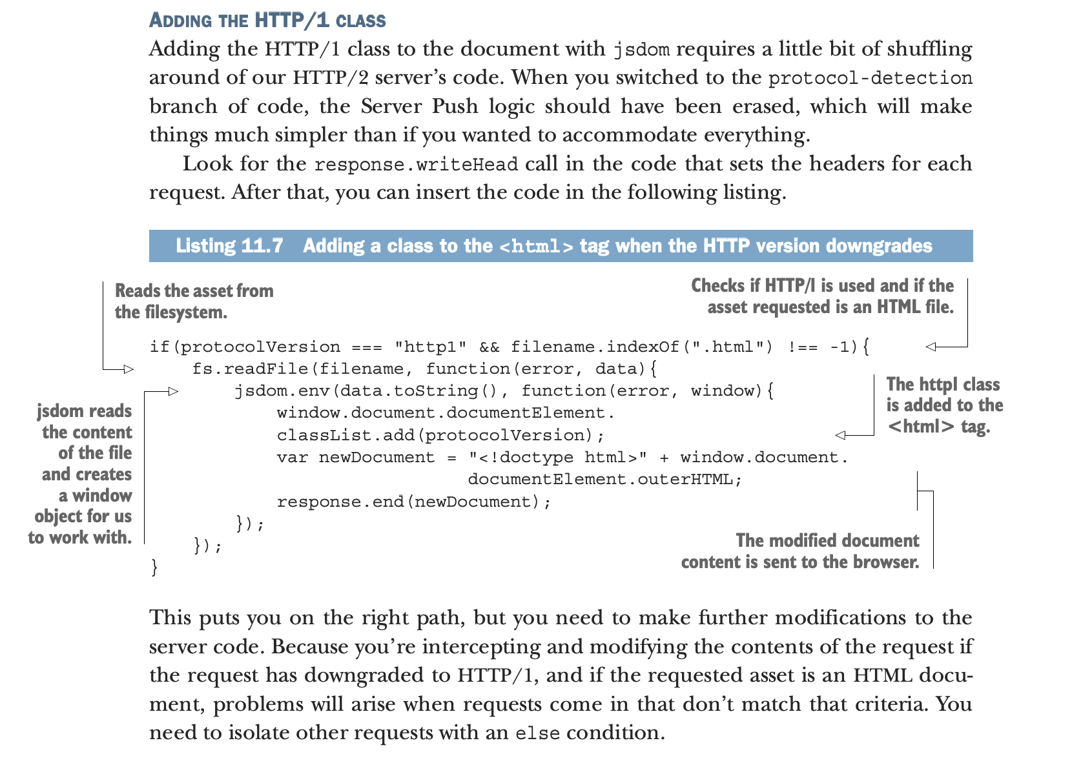

Slide 32
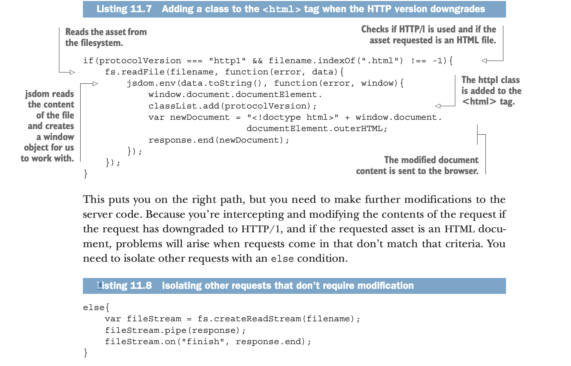

Slide 33
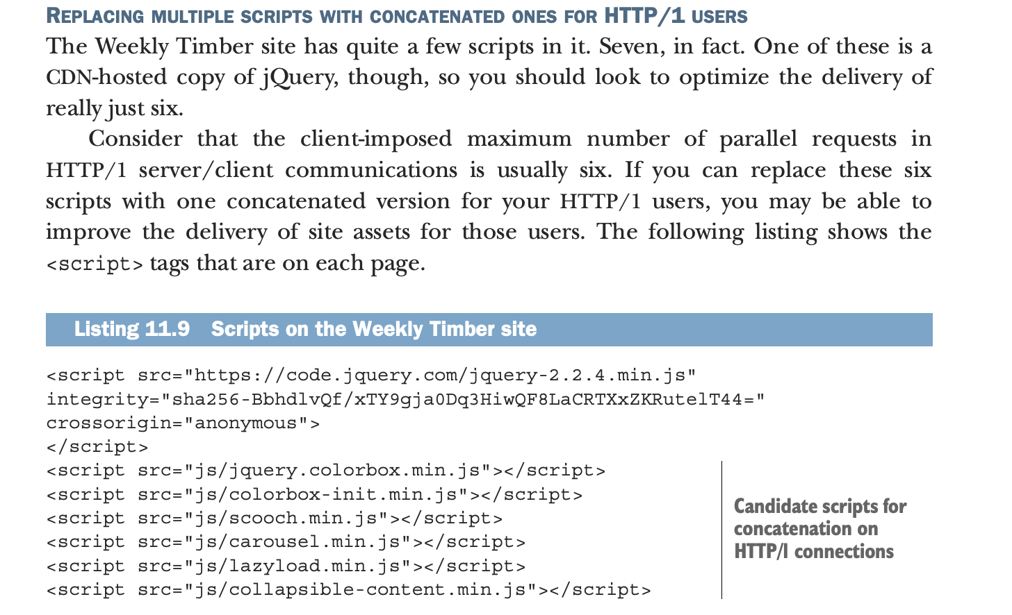

Slide 34
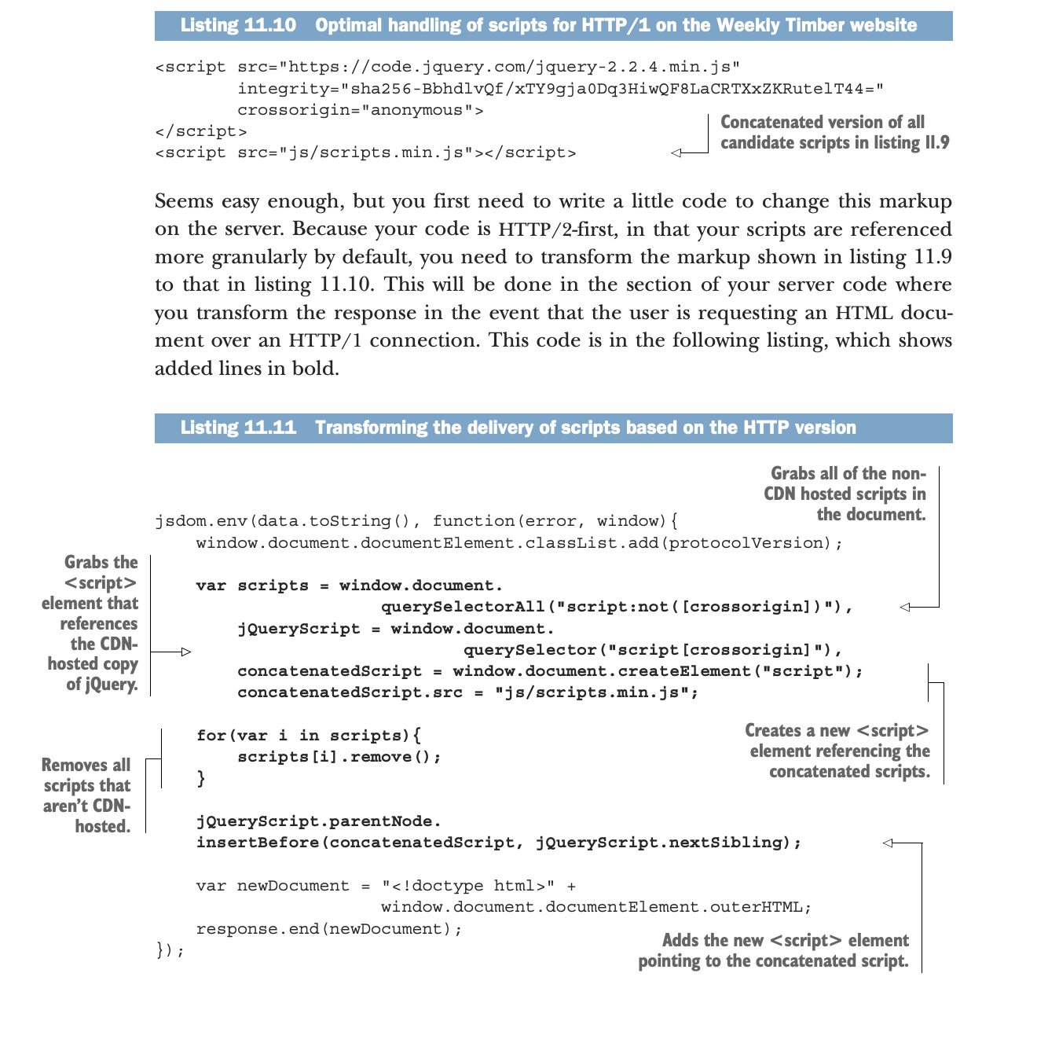

Slide 35
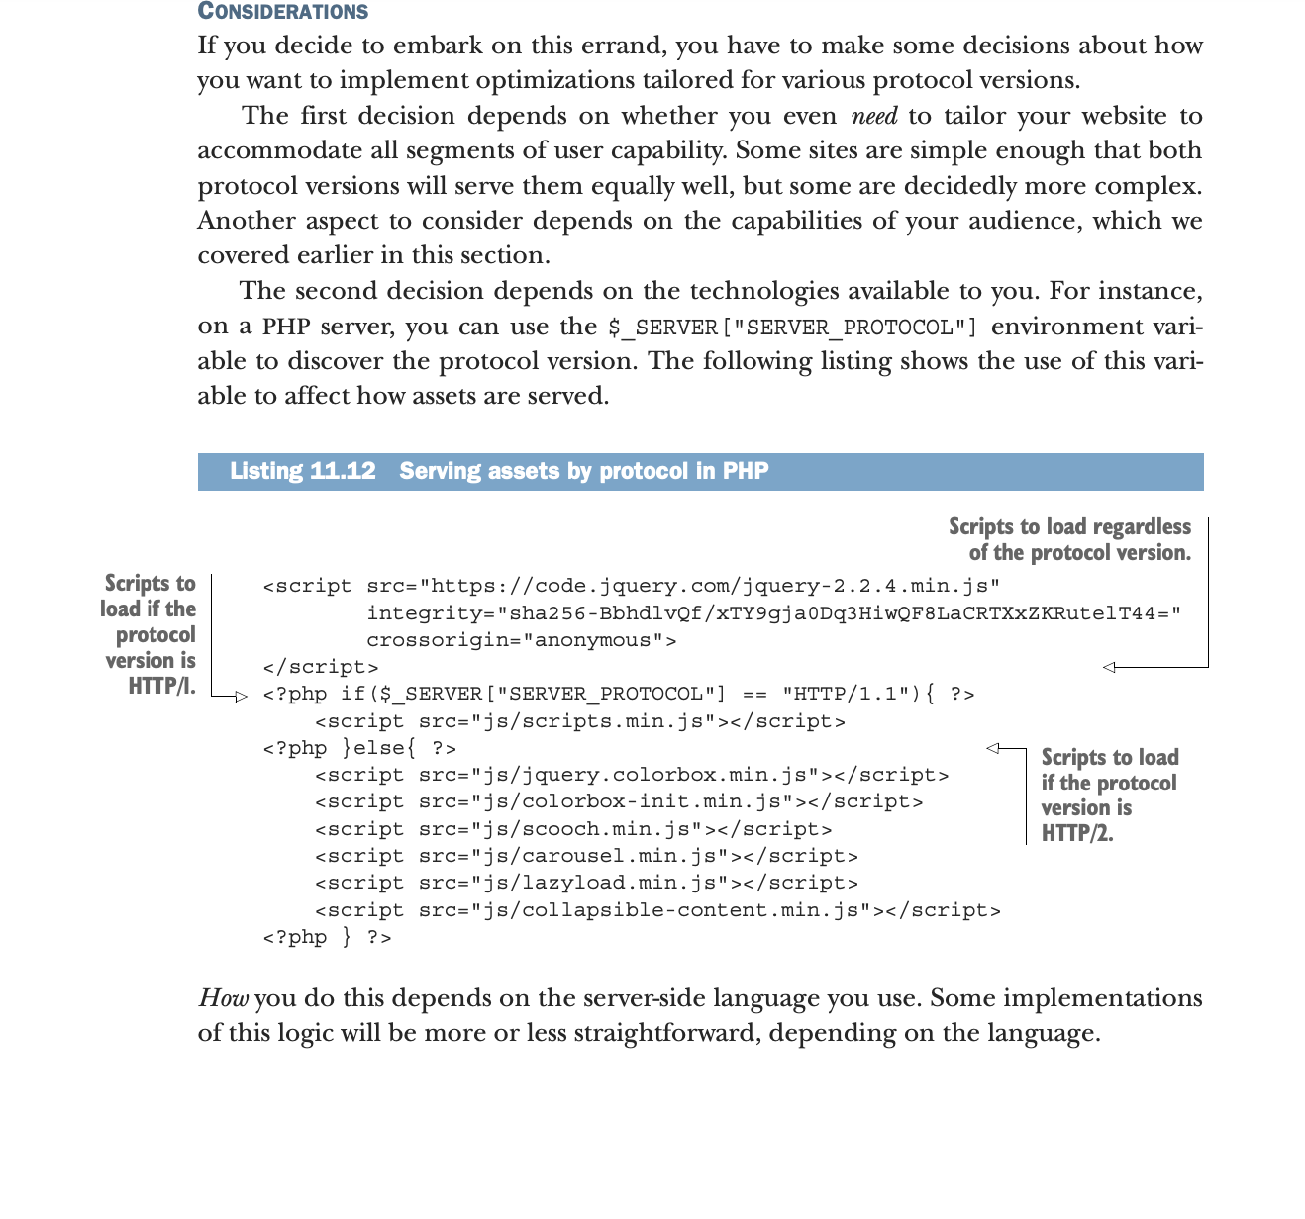

Slide 36
This chapter covers:-
 Understanding how gulp works and why you should use it.
 Structuring your project for use with gulp .
 Installing gulp plugins.
 Understanding how gulp tasks work .
 Writing tasks for your project .
 Testing your gulp-based build system on a client’s website.

Slide 37
Introducing gulp
When Node went mainstream, it became the conduit through which all sorts of useful tools were created by and for web developers.
Before long, it was used to create complex tools such as unit-testing software, package managers, and even build systems. gulp is a Node-based build system. In this section, you’ll learn why you should consider gulp, as well as how gulp works.
Why should I use a build system?
gulp bills itself as a streaming build system. It automates tasks for you that you’d otherwise have to do yourself. When you use a build system, you’re free to focus on being productive.
“But why should I use a build system? The way I do stuff now works good enough for me!” This is the kind of thing I said to myself when tools like this started to become more common, and for the most part, the way I was doing my work was fine. Except that it was extremely repetitive. I use LESS in many of my projects, and whenever I’d make changes to my LESS files, I’d go through a process like the one in figure .

Slide 38
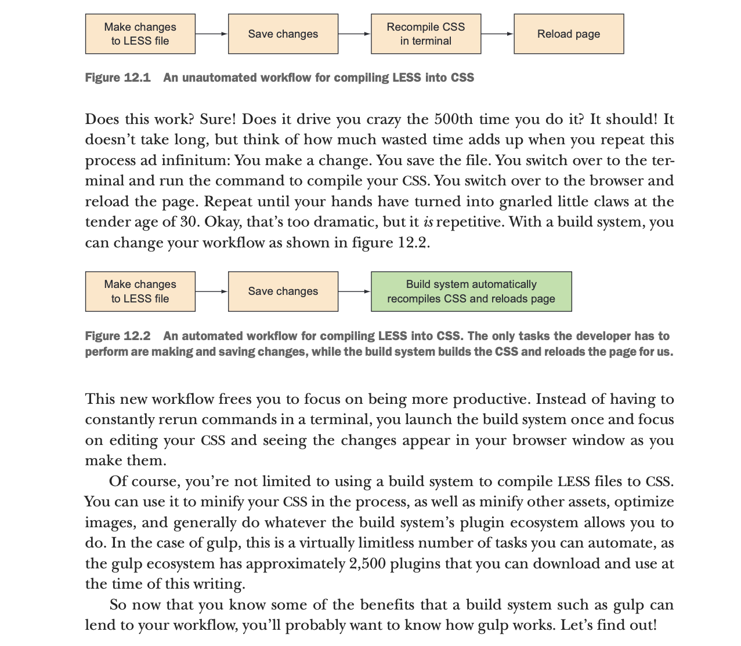

Slide 39
How gulp works
As I said before, gulp bills itself as a streaming build system, but what does that even mean? Streams are points in gulp’s build process where data is transformed. Multiple streams can be chained to create tasks.
Let’s start by talking about how streams work. HOW STREAMS WORK
Streams are an old concept of I/O, and in gulp, they allow you to transform the input of data via plugins, and then pipe that transformed input as output. This process of a single point in a stream as it relates to compiling
LESS files is shown in figure 12.3. This is the simplest representation of data I/O as it works in gulp. Some input data, usually a file on disk, is piped into a stream that’s transformed by a plugin of some Save changes Make changes to LESS file Recompile CSS in terminal Reload page Figure 12.1 An unautomated workflow for compiling LESS into CSS Save changes Make changes to LESS file Build system automatically recompiles CSS and reloads page Figure 12.2 An automated workflow for compiling LESS into CSS. The only tasks the developer has to perform are making and saving changes, while the build system builds the CSS and reloads the page for us. 306 CHAPTER 12 Automating optimization with gulp sort. The transformed data is then output by the stream, which can then either be written to disk or passed into further streams prior to that step. Figure 12.4 shows a chain of streams connected to transform data multiple times

Slide 40
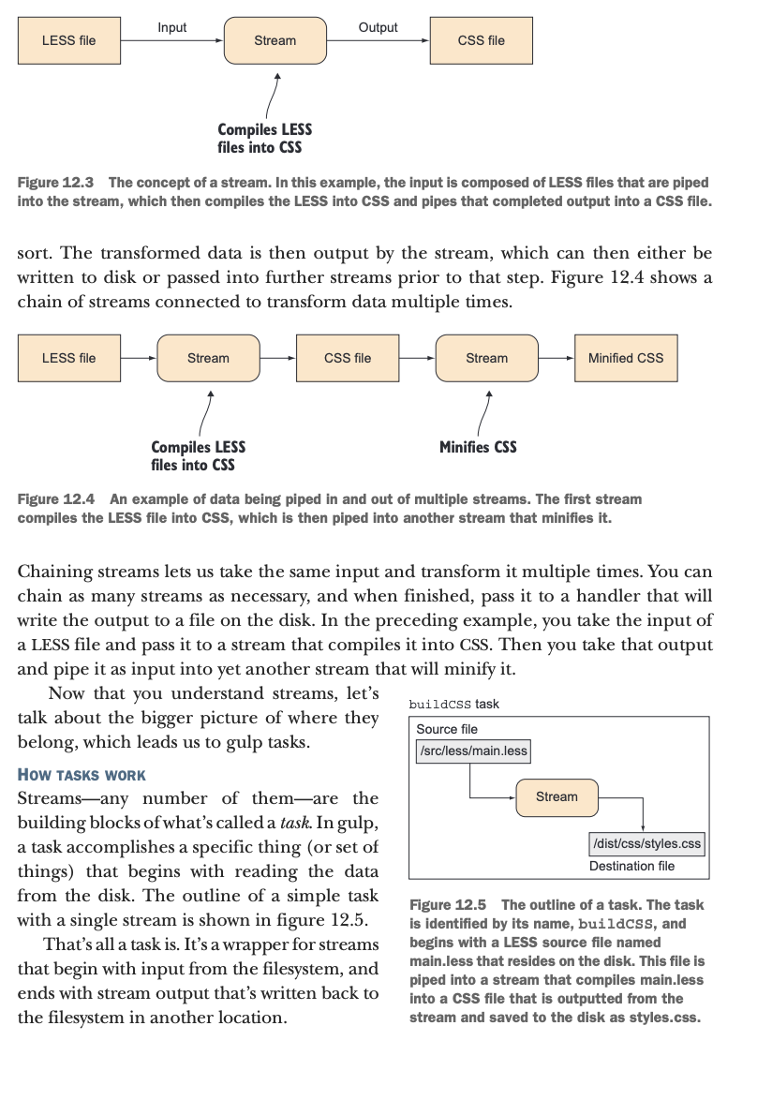

Slide 41
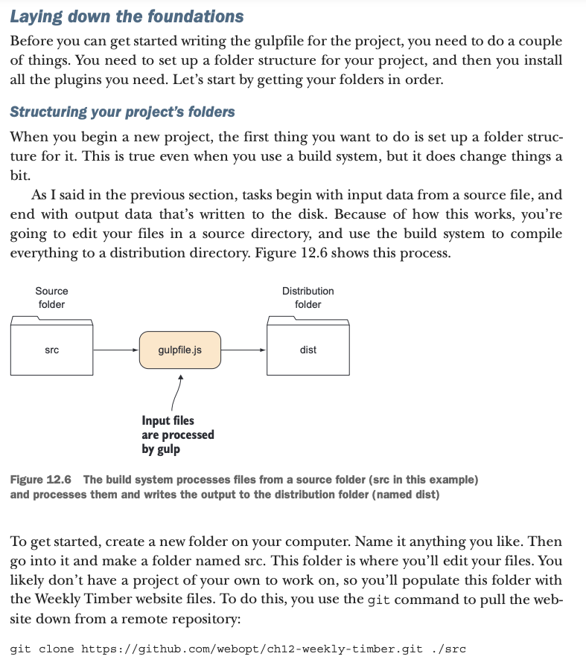

Slide 42
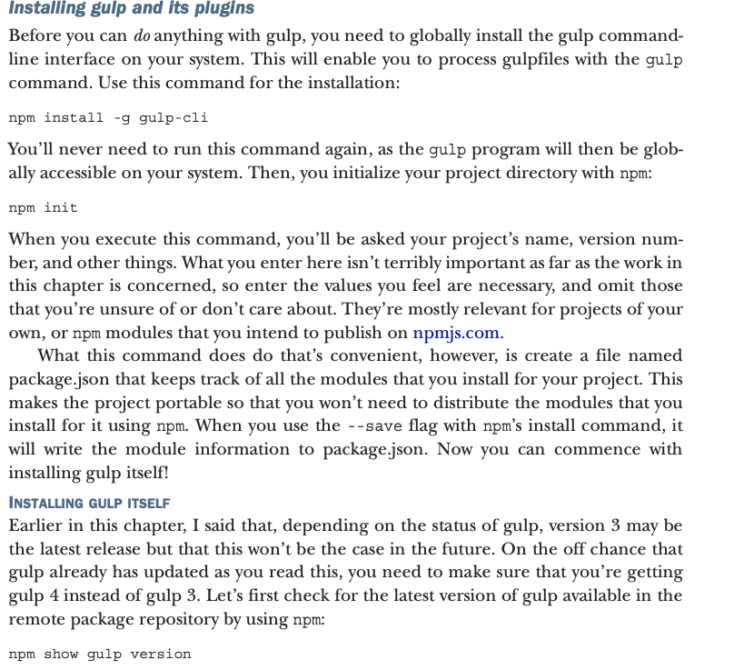

Slide 43
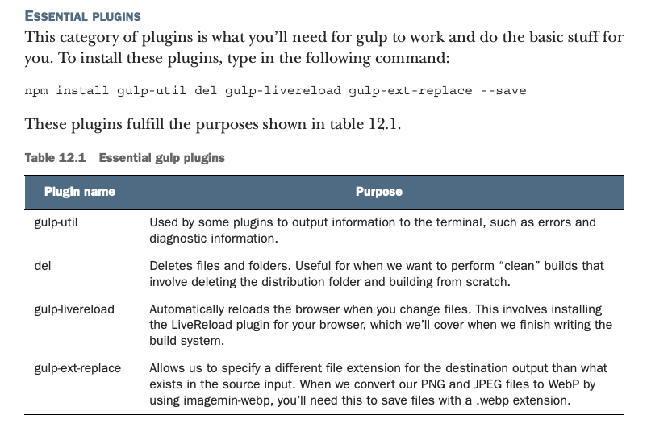

Slide 44
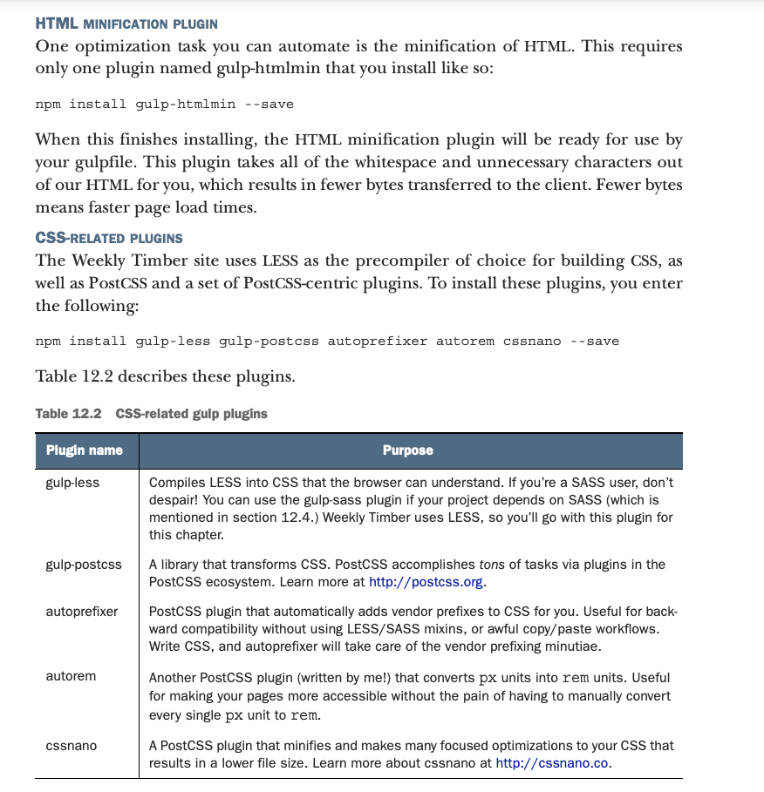

Slide 45


Slide 46
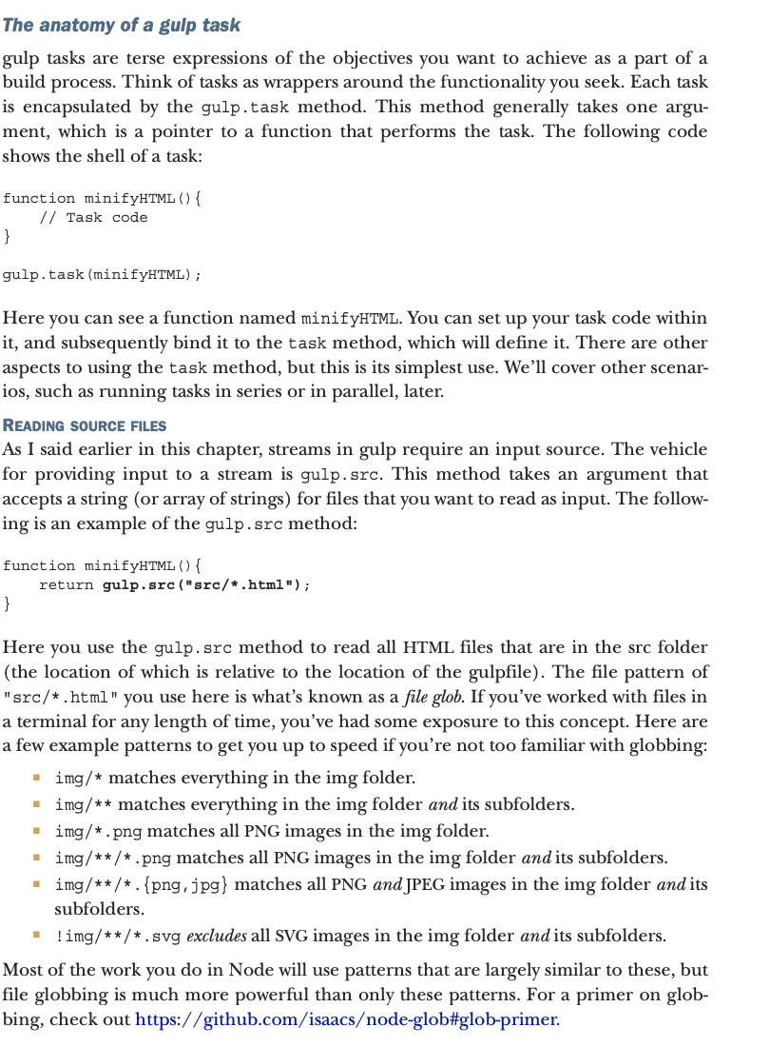

Slide 47
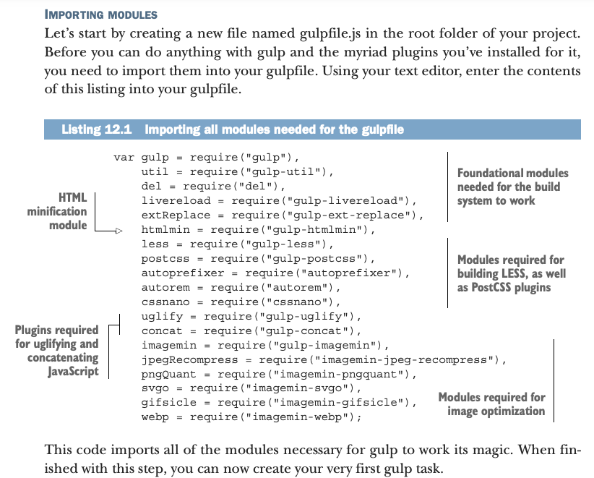

Slide 48
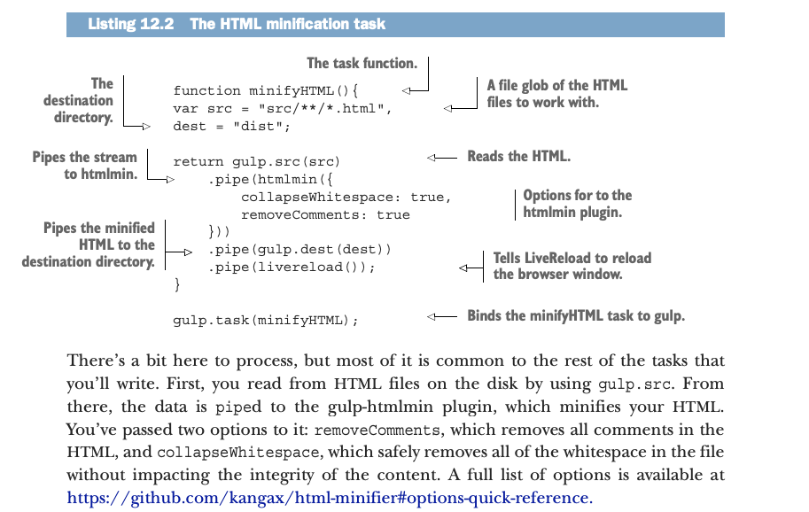

Slide 49
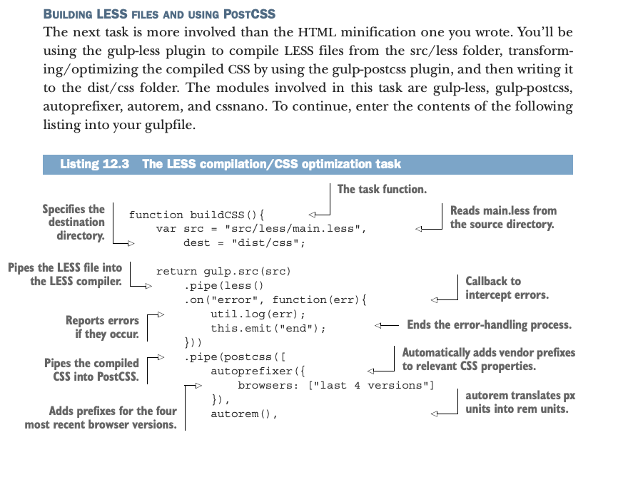

Slide 50
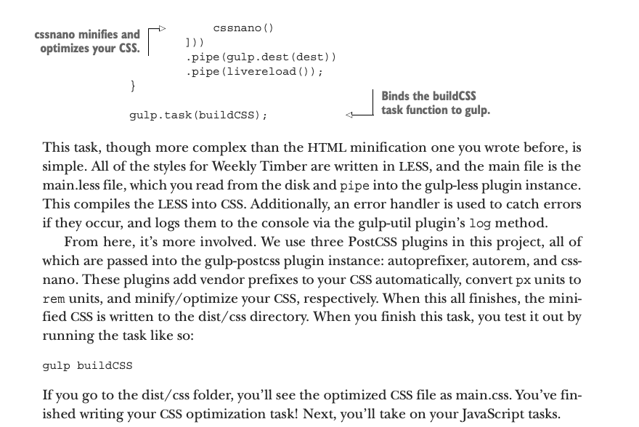

Slide 51
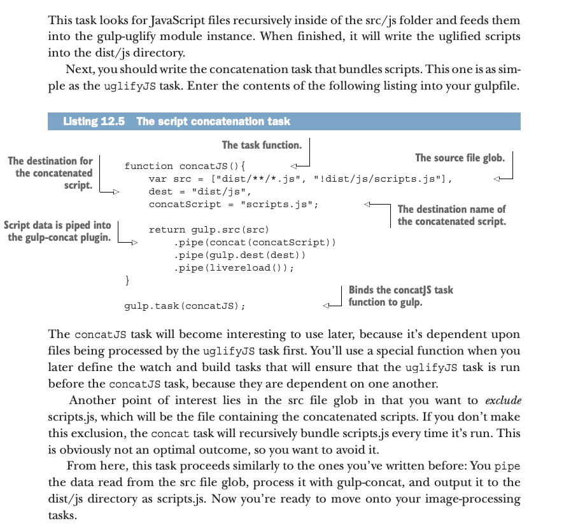

Slide 52
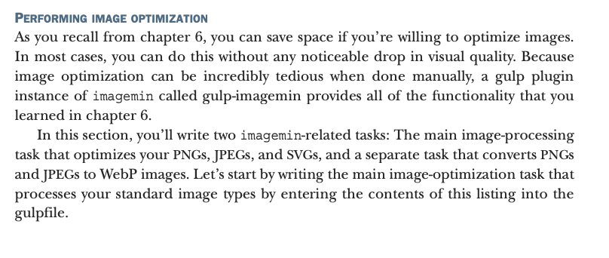

Slide 53
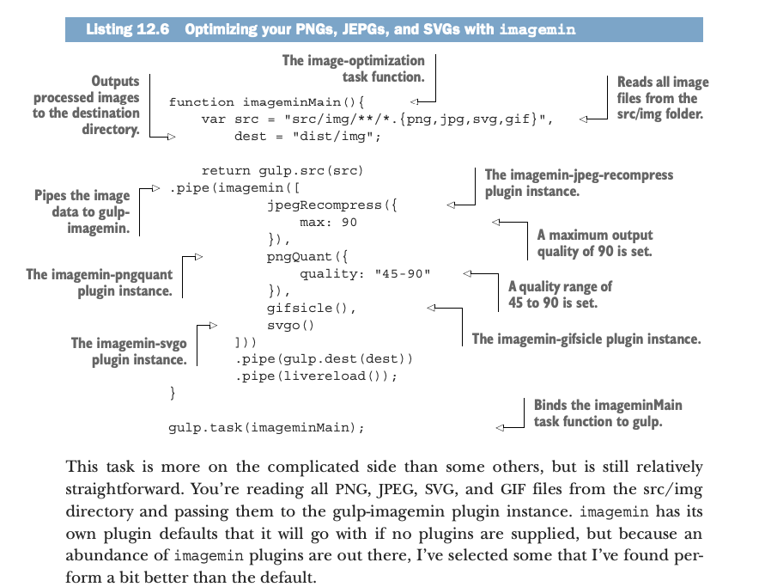

Slide 54
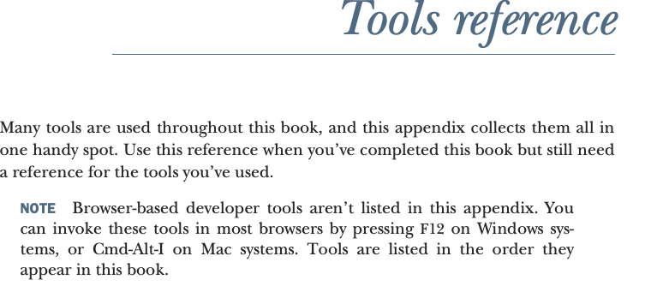

Slide 55
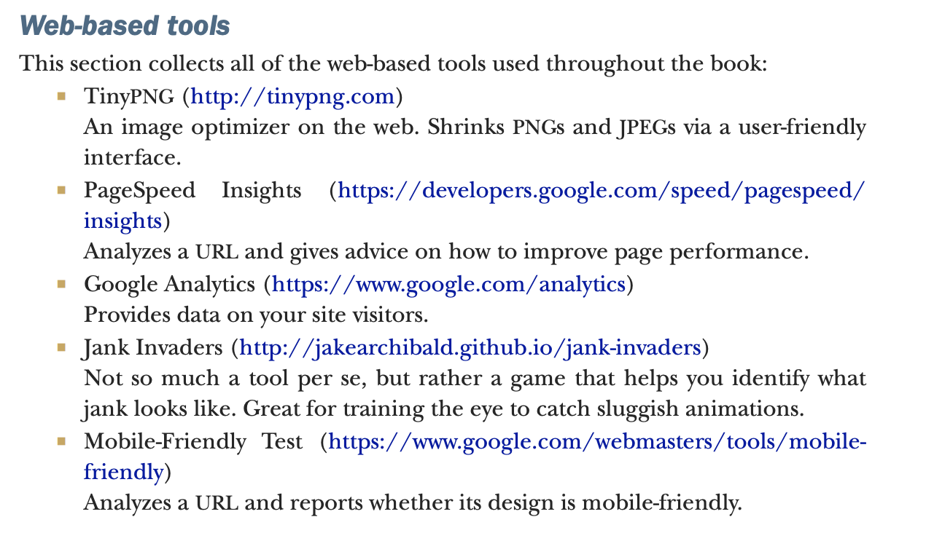

Slide 56
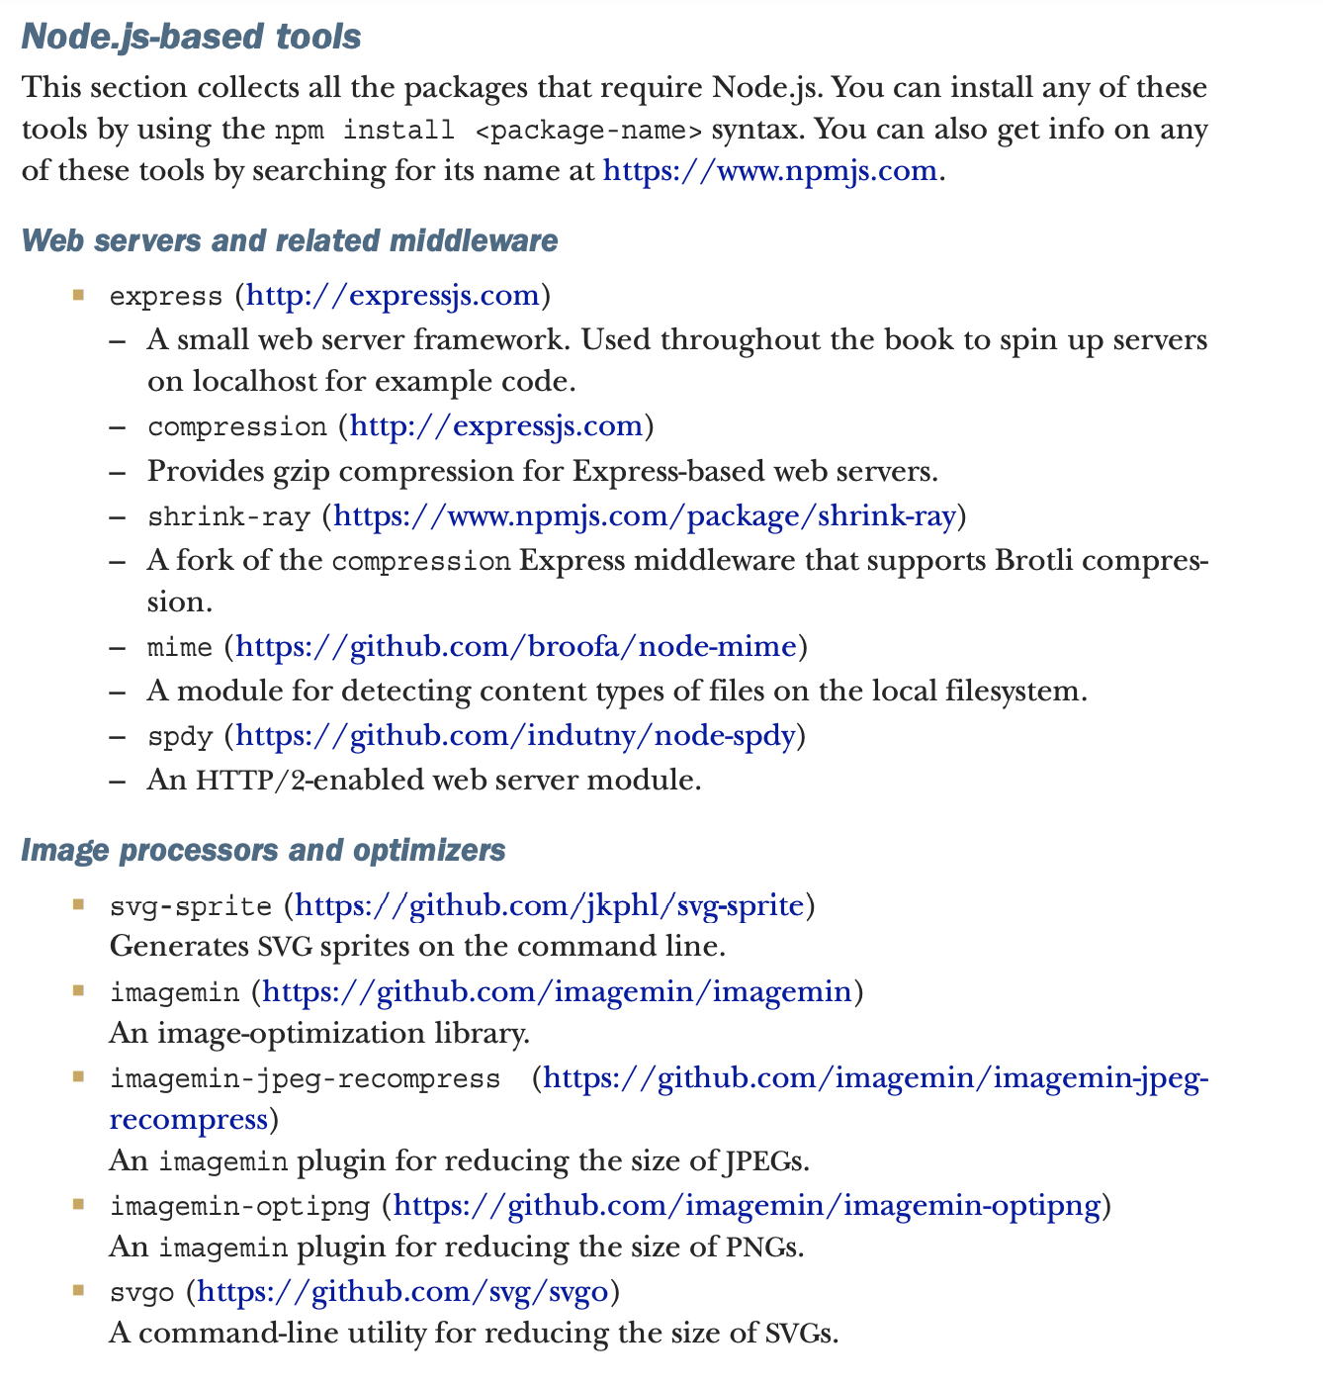

Slide 57
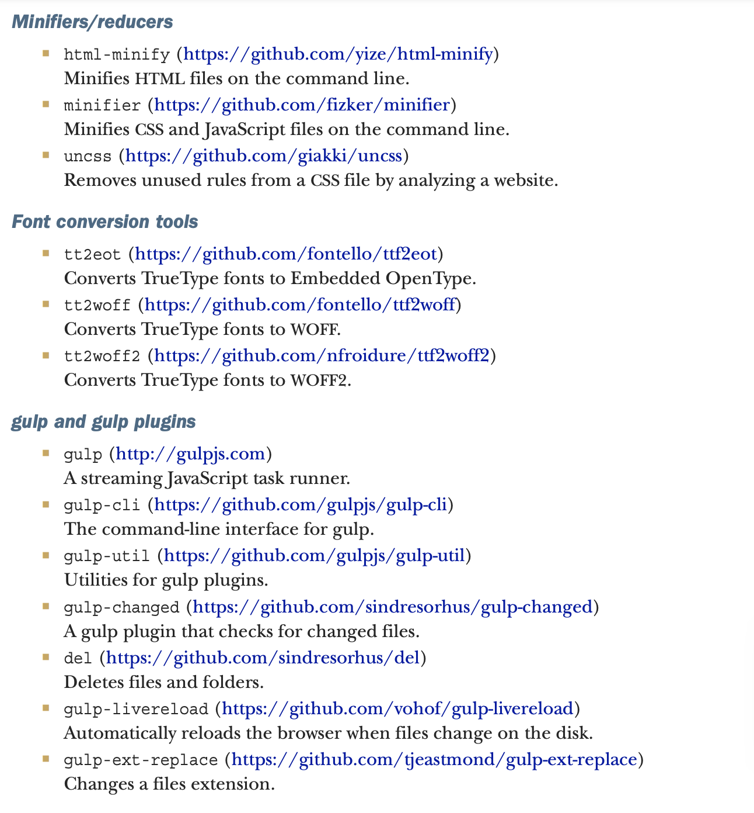

Slide 58
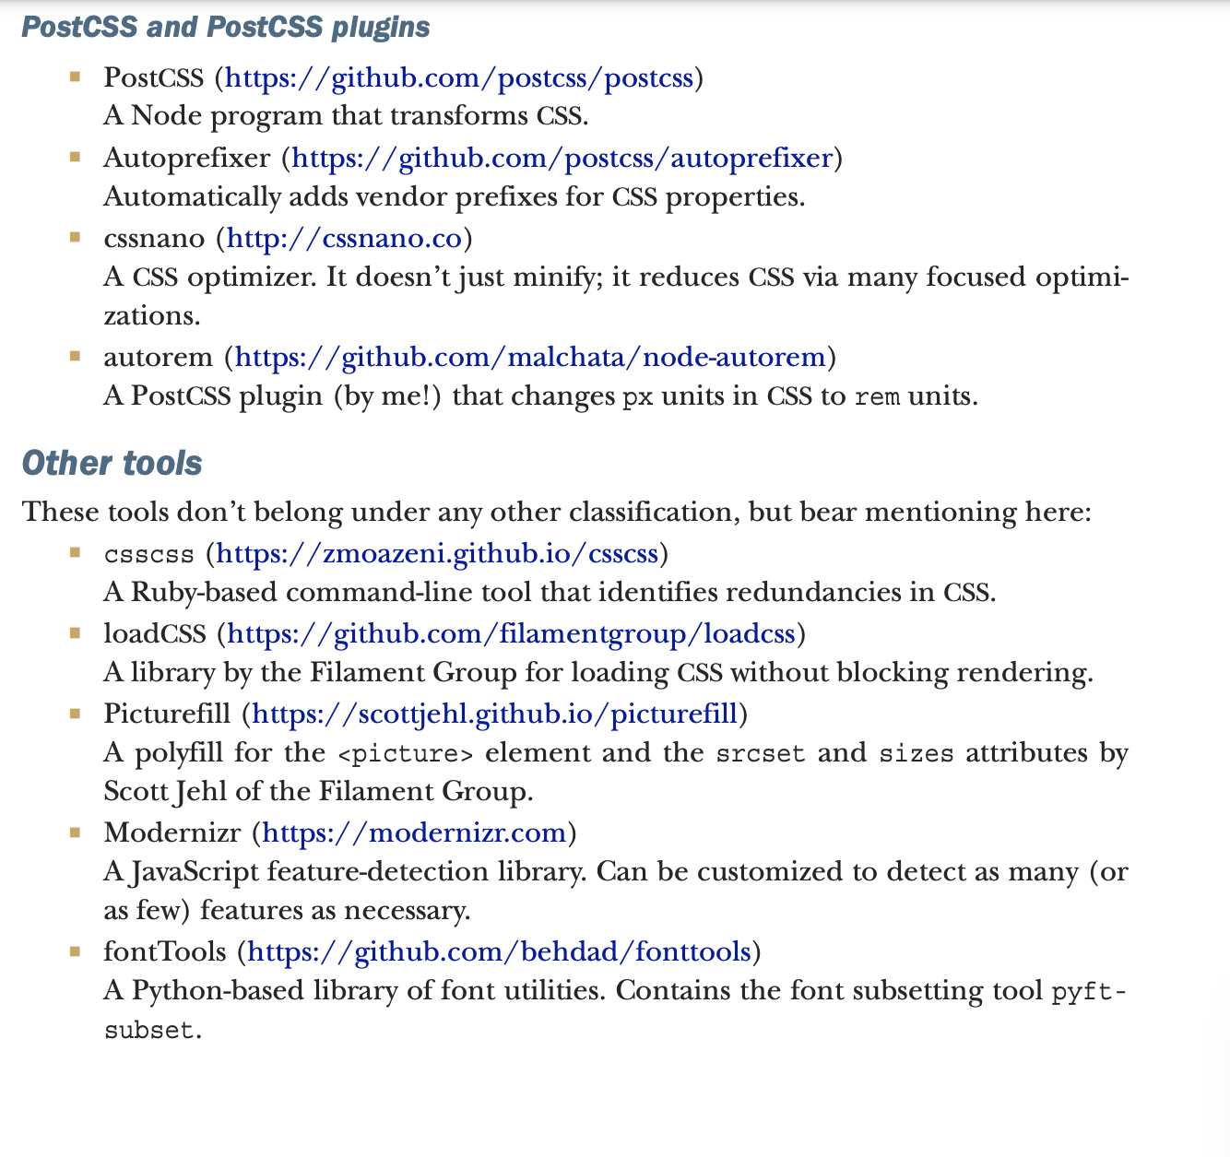

Slide 59
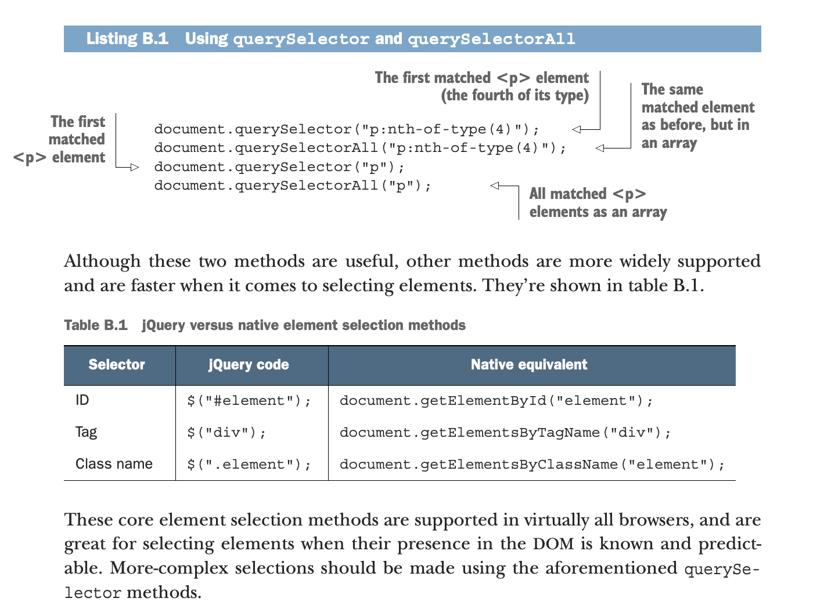

Slide 60
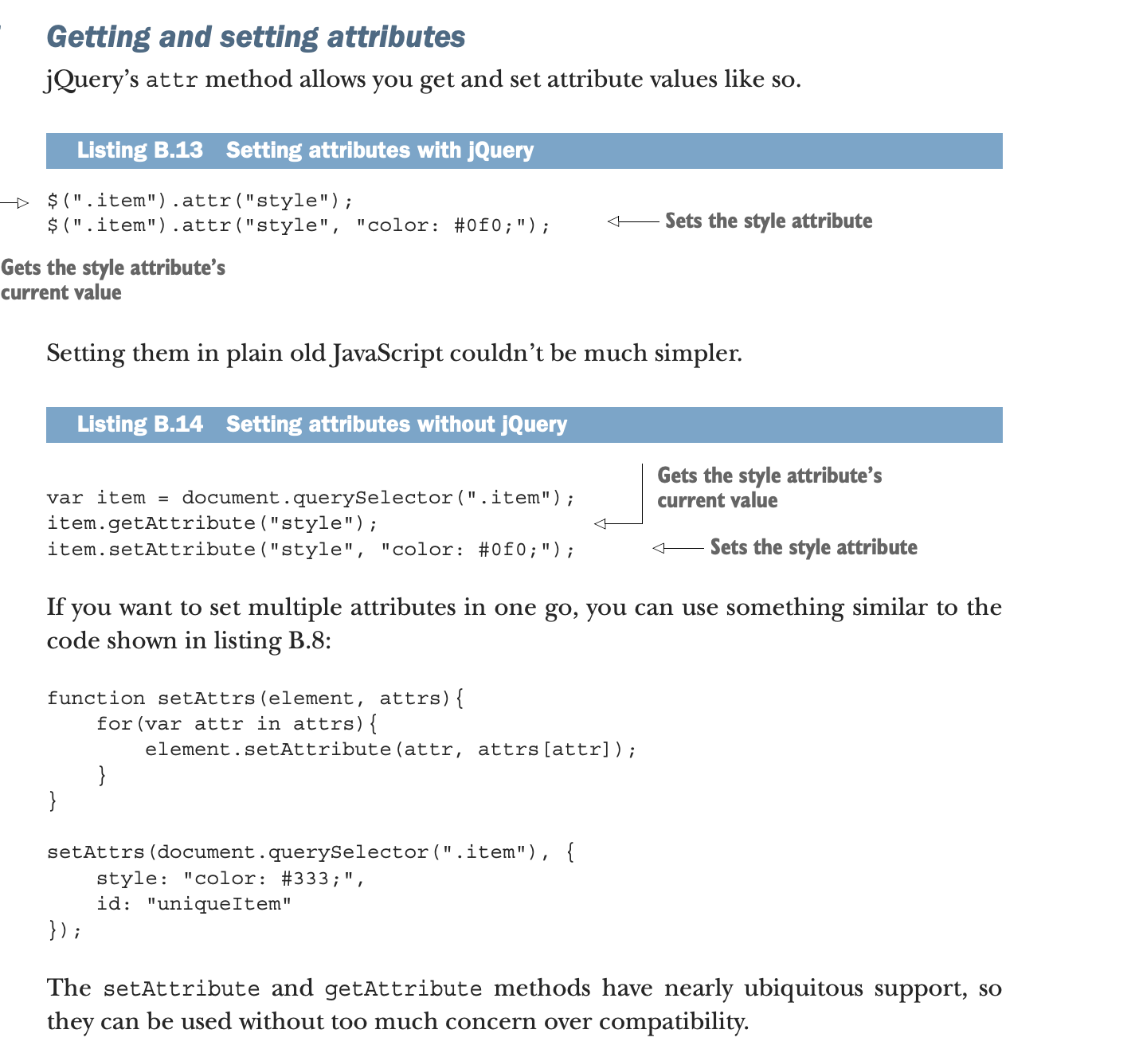

Slide 61
